Slide 1
Using The National Health and Nutrition Examination Survey (NHANES) to Predict Heart Disease
Final Capstone
March 2020
Presented by
Kathie King

Slide 2
Introduction: context of the project
Heart disease is the leading cause of death for men, women, and people of most racial and ethnic groups in the United States.
About 647,000 Americans die from heart disease each year—that’s 1 in every 4 deaths.
Heart disease costs the United States about $219 billion each year from 2014 to 2015. This includes the cost of health care services, medicines, and lost productivity due to death.
https://www.cdc.gov/heartdisease/facts.htm

Slide 3
Data source: The National Health and Nutrition Examination Survey (NHANES)
What is NHANES?
a major program of the National Center for Health Statistics (NCHS), which is part of the Centers for Disease Control and Prevention (CDC)
began in the early 1960s as a program of studies designed to assess the health and nutritional status of adults and children in the United States
changed in 1999 to became a continuous program with a changing focus on a variety of health and nutrition measurements to meet emerging needs
examines a nationally representative sample of about 5,000 persons each year

Slide 4
Data source: The National Health and Nutrition Examination Survey (NHANES)
Why NHANES?
Unique in that it combines interviews
interview includes demographic, socioeconomic, dietary, and health-related questions
AND Physical examinations
include laboratory tests and physiological measurements, administered by highly trained medical personnel.
Findings from this survey are used:
To determine the prevalence of major diseases and risk factors for diseases
To assess nutritional status and its association with health promotion and disease prevention
As the basis for national standards for such measurements as height, weight, and blood pressure
In epidemiological studies and health sciences research
To develop public health policy and to direct and design health programs and services

Slide 5
The Problem
The link between diet/nutrition and cardiac disease is long established
Understanding exactly what that link is has been incompletely understood and continues to evolve over time.
The goal of this capstone is to attempt to better understand the link between diet/nutrition and cardiac disease by exploring the relationship between various diet components, nutrients, and behaviors around nutrition.

Slide 6
Purpose of the Project
Medical science continues to search for both prevention methods and treatment methods to tackle the morbidity and mortality presented by cardiac disease.
This Capstone Project, although limited in size of data, can offer additional insights into the relationship between diet/nutrition and cardiac disease.
Much like a pilot study, the results of this study may offer researchers an insight into a specific nutrient or dietary behavior that warrants further study on a larger scale.

Slide 7
Original data sets
All data sets obtained from NHANES 2015 – 2016 cycle
Demographic data: 1 file
Demographic Variables and Sample Weights
Examination data: 2 files
Blood Pressure Measurements
Body Measurements

Slide 8
Original data sets
Laboratory data: 5 files
Cholesterol – High Density Lipid (HDL)
Cholesterol – Total
Complete Blood Count with 5-Part Differential - Whole Blood
High-Sensitivity C-Reactive Protein (hs-CRP)
Standard Biochemistry Profile
Questionnaire data: 2 files
Blood Pressure & Cholesterol
Medical Conditions

Slide 9
Original data sets
Dietary data: 4 files
Dietary Interview - Total Nutrient Intakes, First Day
Dietary Interview - Total Nutrient Intakes, Second Day
Dietary Supplement Use 24-Hour - Total Dietary Supplements, First Day
Dietary Supplement Use 24-Hour - Total Dietary Supplements, Second Day

Slide 10
Original data sets: counts
File Name | Unique “SEQN” Count | Total File Count
Demog_df | 9972 | 10,000
Med_cond | 9575 | 9600
Body_measures_df | 9545 | 9600
Bp_quest_df | 6328 | 6400
Cbc_df | 9166 | 9200
Hdl_df | 8022 | 8100
Tot_chol_df | 8022 | 8100
Hscrp_df | 9166 | 9200
Std_chem_df | 6745 | 6800
tot_intake1_df | 9545 | 9600
tot_intake2_df | 9545 | 9600
Tot_diet_supp_1_df | 9545 | 9600
Tot_diet_supp_2_df | 9545 | 9600
Total Count | 114,721 | 115,400

Slide 11
Merging, Cleaning, Wrangling
Merging:
Final file: 10,027 entries x 216 columns
Missing lab info for ~33% of unique “SEQN” files
unable to accurately fill; drop for full exploration
Combining & Calculating:
Target value: positive indicator for any of 4 questions re heart disease
Calculating average of individual nutrient + supplement intake over 2 days
Final data file:
4712 entries x 168 columns

Slide 12
Target value
MCQ160B: Ever told you had congestive heart failure?
No/don’t know = 3731 + 862 = 4593
MCQ160C: Ever told you had coronary heart disease?
No/don’t know = 3689 + 872 = 4561
Yes = 119
Yes = 151

Slide 13
Target value
MCQ160D: Ever told you had angina/angina pectoris?
No/don’t know = 3754 +864 = 4618
Yes = 94
MCQ160E: Ever told you had heart attack?
No/don’t know = 3691 + 863 = 4554
Yes = 158
'heart_dz’ value counts
No (0) = 4403
Yes (1) = 309

Slide 14
Additional wrangling
Outliers:
Reduced using log transformation
Retained small number of outliers to reflect the possibility that extreme values may be influential in indicating heart disease
Categorical variables:
Multiple possible answers
Converted to dummy variables using ‘pd.get_dummies’, drop first

Slide 15
Unsupervised Learning
Used 3 data sets:
Combined (body measurements + lab data)
Body measurements
Lab data
Attempted clustering 3 ways:
kmeans cluster, mini batch kmeans, and means shift
Clustering

Slide 16
Unsupervised Learning: Clustering
Best performing clusters per silhouette score:
combined cluster (body measurements & labs), means shift : 0.2584470929714834;
lab cluster, means shift: 0.25752785123194827;
body measurement cluster, kmeans: 0.17285573317869343;
Add clusters to data set as a variable in supervised model.

Slide 17
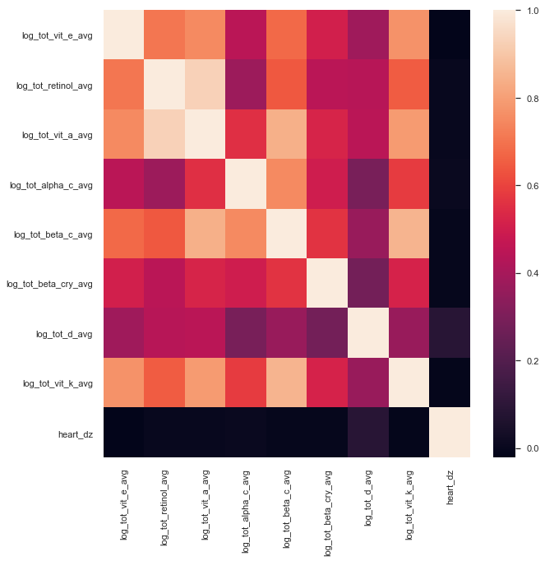
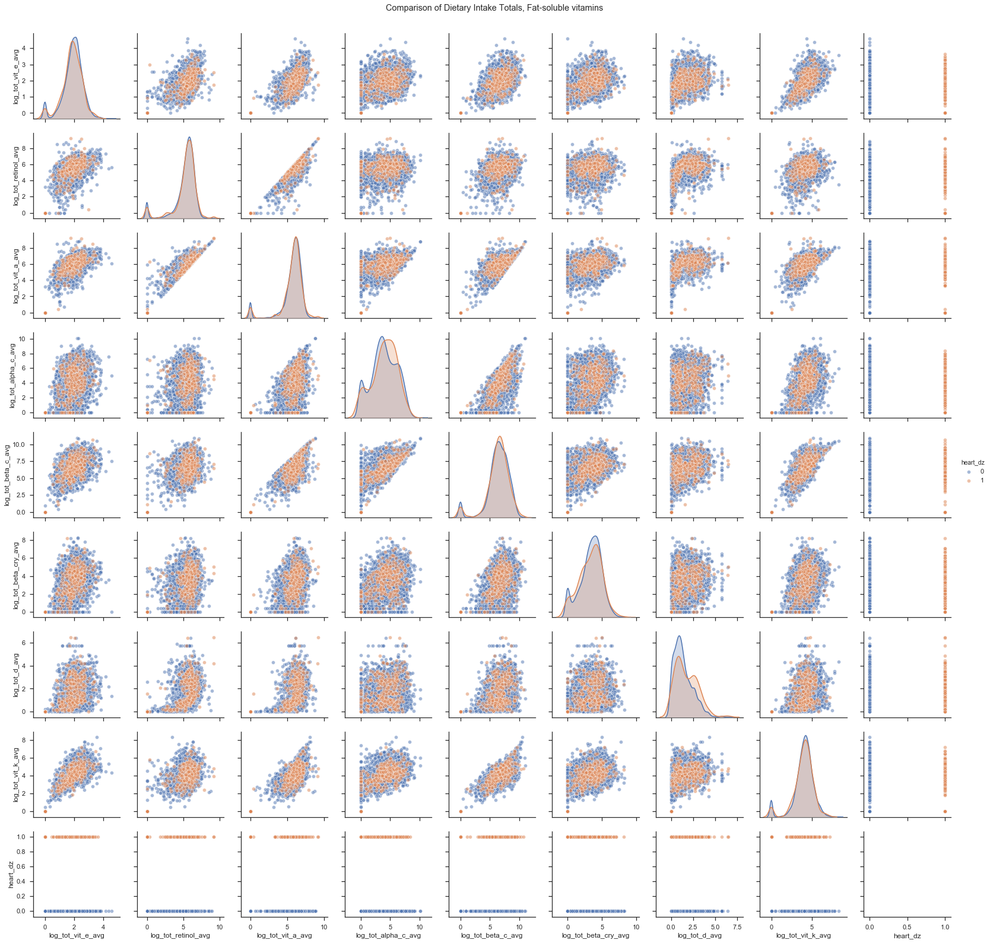
Supervised Learning: Visualize final data set (fat-soluble vitamins)

Slide 18
Supervised Learning: Final data set
Classification problem:
Finding best features to indicate presence of heart disease
Remove highly correlated features
Pair-plots suggest non-linear relationships
Multiple features available (107)
Balanced vs Imbalanced data set
Class 0: No heart disease indicated: 4403 (93.44%)
Class 1: Heart disease indicated: 309 (6.56%)

Slide 19
Supervised Learning: Models
Models to run:
Random Forest Classifier
Gradient Boosting Classifier
Support Vector Classifier
Feature engineering
Hyperparameter tuning
Important Metrics:
Recall Class 1
F1-score Class 1
Confusion Matrix – maximize number of true positive for Class 1
AUC-ROC vs accuracy

Slide 20
Supervised Learning: Random Forest Classifier
Multiple runs of model with manipulation of above parameters
Best run: balanced data (SMOTE, oversample class 1), top 15 features, default hyperparameters
Metrics:
Cross-validation mean score for top 15 features: 0.948072479713932
ROC-AUC mean score for top 15 features: 0.9859698648112545
Accuracy score top 15 features: 0.8896434634974533

Slide 21
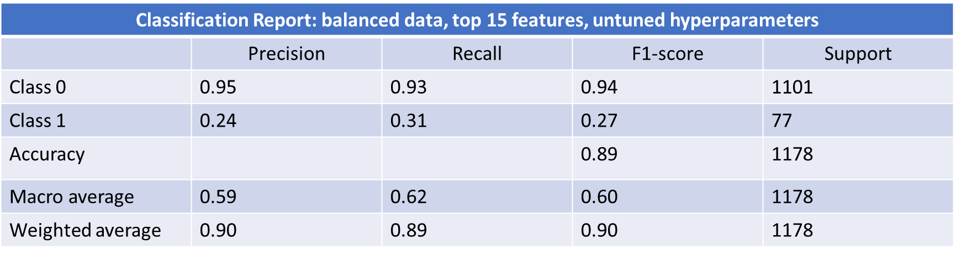
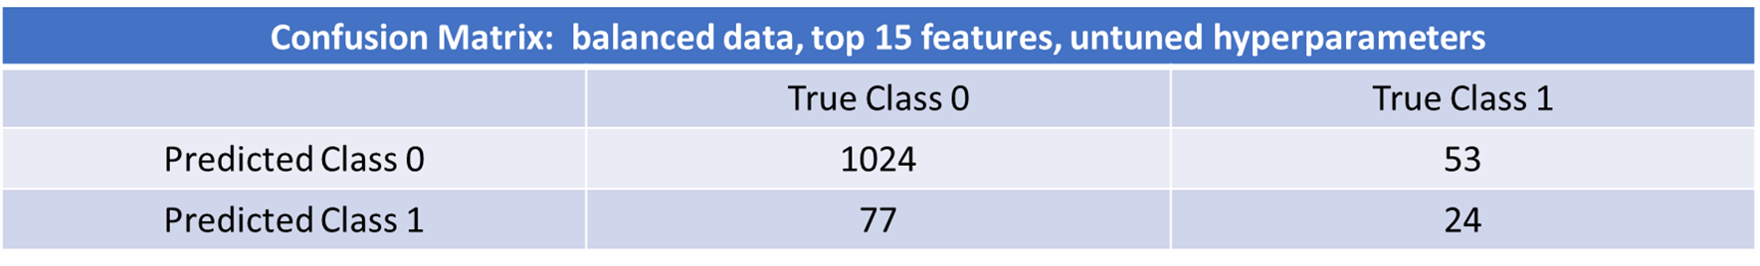
Supervised Learning: Random Forest Classifier

Slide 22
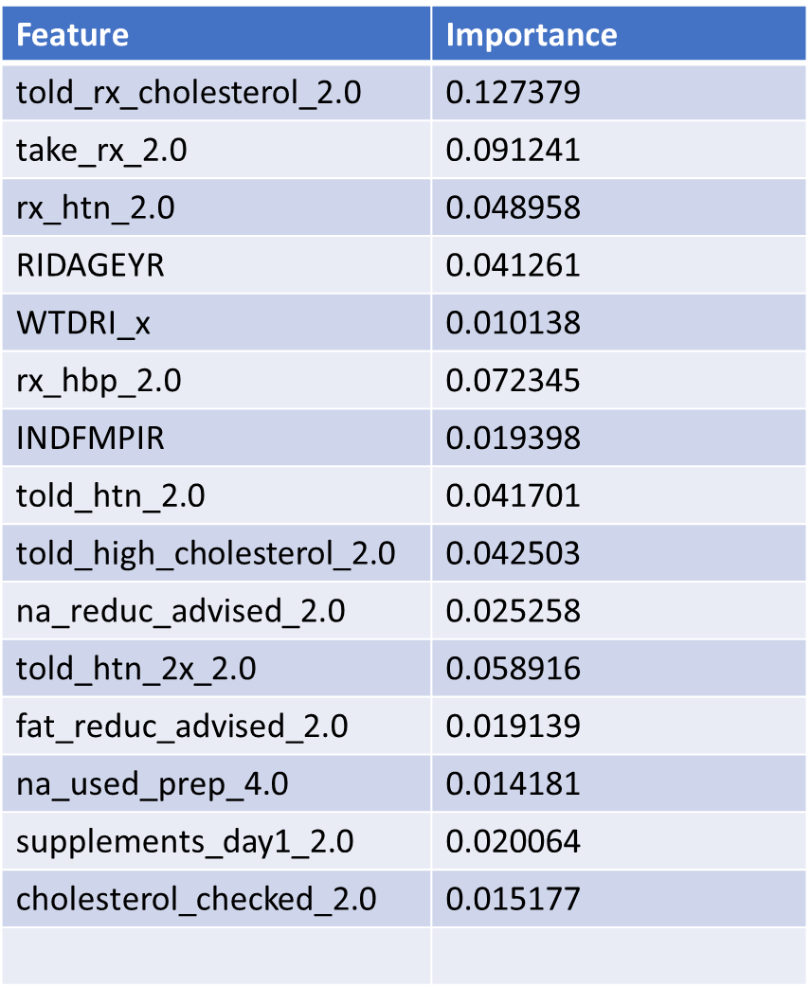
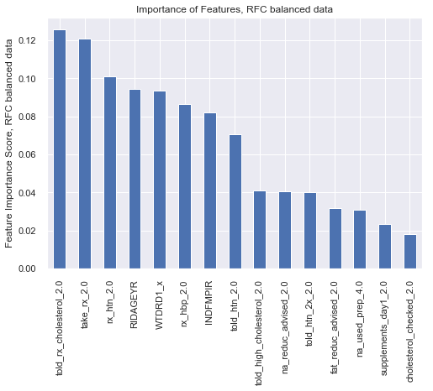
Supervised Learning: Random Forest Classifier, top 15 features

Slide 23
Supervised Learning: Gradient Boosting Model
Multiple runs of model with manipulation of above parameters
Best run: balanced data (SMOTE, oversample class 1), top 15 features, default hyperparameters
Metrics:
Accuracy of GBM, top 15 features: 0.876

Slide 24
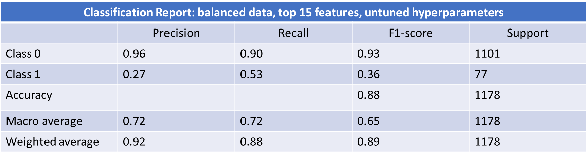

Supervised Learning: Gradient Boosting Model

Slide 25
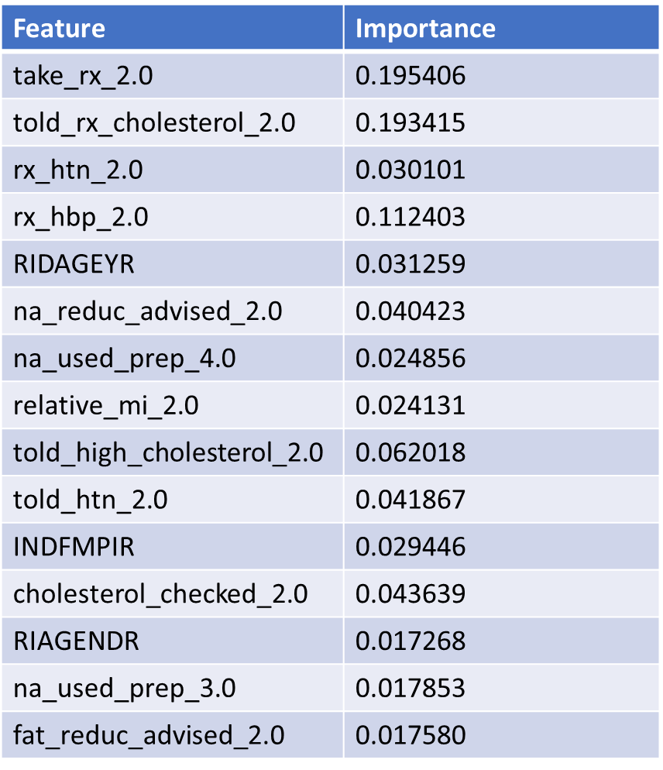
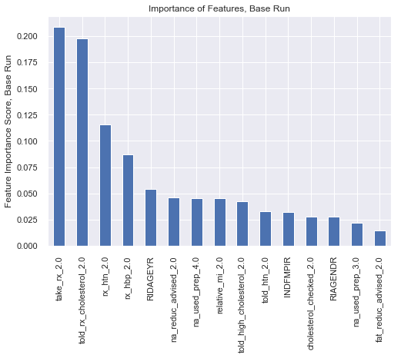
Supervised Learning: Gradient Boosting Model, top 15 features

Slide 26
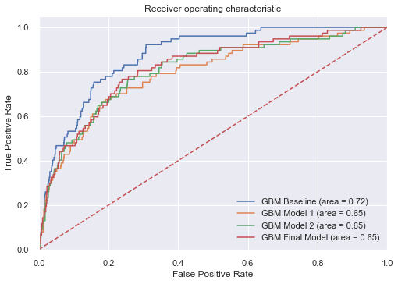
Supervised Learning: Gradient Boosting Model, tuning hyperparameters

Slide 27
Supervised Learning: SVM
Four kernels available:
Linear
Poly
RBF
Sigmoid
Multiple runs of model with manipulation of above parameters and kernels
Best run: linear kernel, balanced data (SMOTE, oversample class 1), top 30 features, default hyperparameters

Slide 28
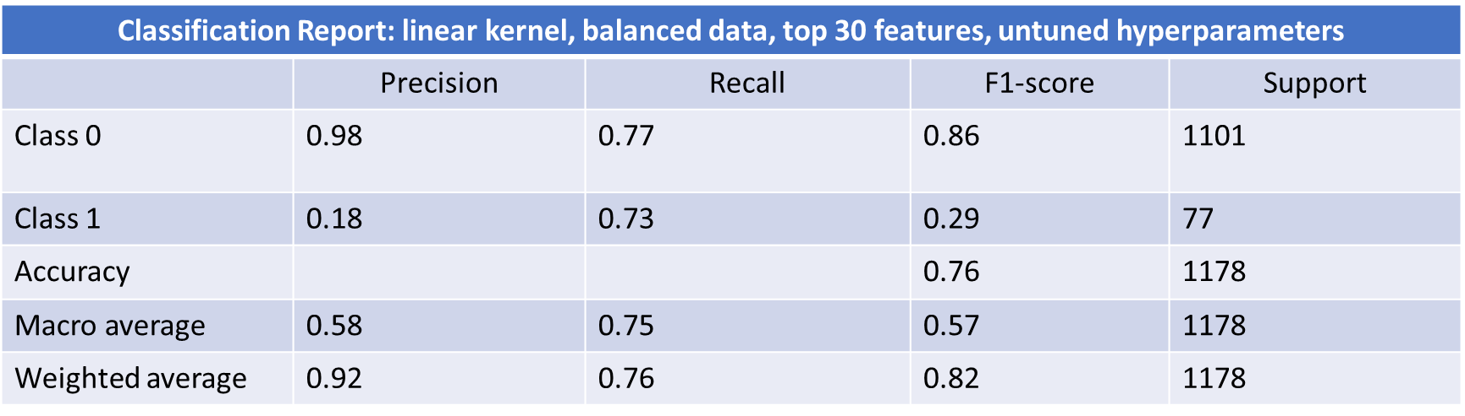
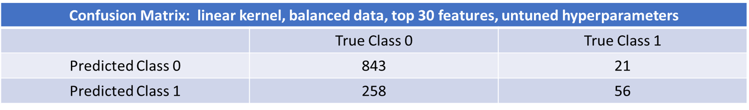
Supervised Learning: SVM

Slide 29
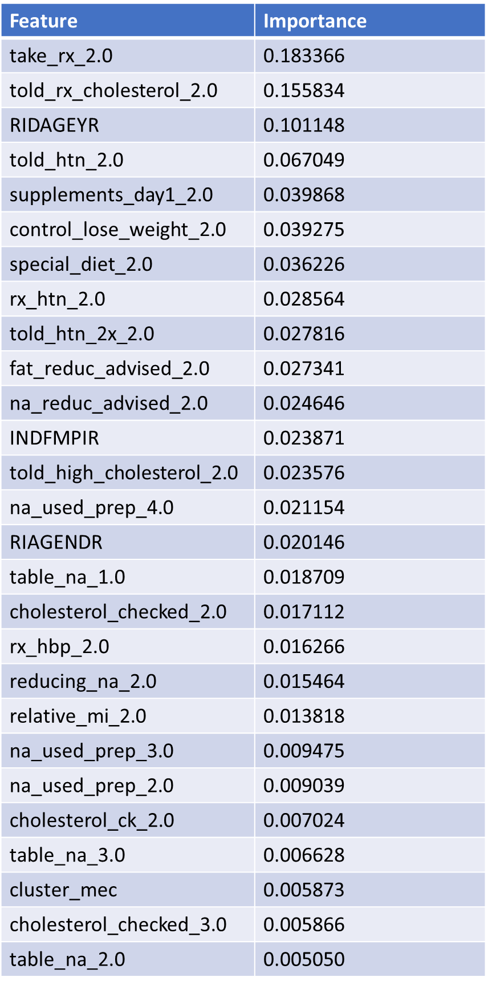
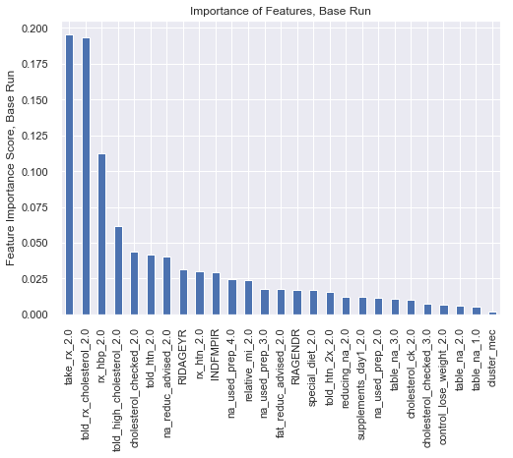
Supervised Learning: SVM, top 30 features (from GBM model)

Slide 30
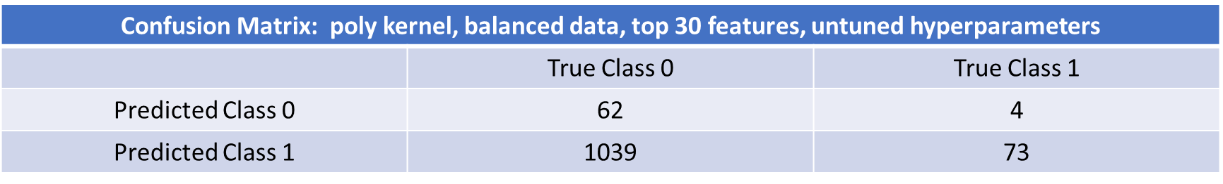
Supervised Learning: SVM, also best?
Classification Report: poly kernel, balanced data, top 30 features, untuned hyperparameters
 | Precision | Recall | F1-score | Support
Class 0 | 0.94 | 0.06 | 0.11 | 1101
Class 1 | 0.07 | 0.95 | 0.12 | 77
Accuracy |  |  | 0.11 | 1178
Macro average | 0.50 | 0.50 | 0.11 | 1178
Weighted average | 0.88 | 0.11 | 0.11 | 1178

Slide 31
Best Model
SVM linear kernel, balanced data, top 30 features, untuned hyperparameters
Balance trade-off of precision for recall
Clinical value/perspective
What else can we learn?

Slide 32
Biostatistics
Time-to-event (survival analysis)
Indicating likelihood of onset of heart disease by age
Differences in gender at onset of heart disease
Likelihood to develop heart disease by age

Slide 33
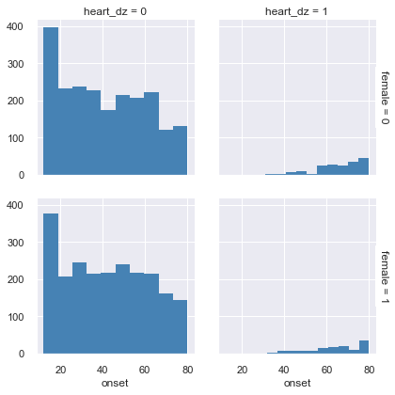
Biostatistics: current incidence of heart disease by gender/age

Slide 34
Biostatistics: time-to-event summary
Time | Surv prob | Surv prob SE | Number at risk | Number events
32 | 0.999360 | 0.000640 | 1563 | 1.0
37 | 0.997222 | 0.001389 | 1402 | 3.0
38 | 0.995765 | 0.001727 | 1369 | 2.0
41 | 0.002045 | 0.002045 | 1280 | 2.0
45 | 0.987486 | 0.003122 | 1121 | 2.0
50 | 0.984490 | 0.003560 | 944 | 1.0
55 | 0.972916 | 0.005068 | 770 | 3.0
60 | 0.950833 | 0.007512 | 602 | 4.0
65 | 0.917885 | 0.010720 | 421 | 5.0
70 | 0.866525 | 0.015382 | 264 | 4.0
75 | 0.821899 | 0.020097 | 163 | 2.0
80 | 0.569251 | 0.039046 | 94 | 22.0

Slide 35
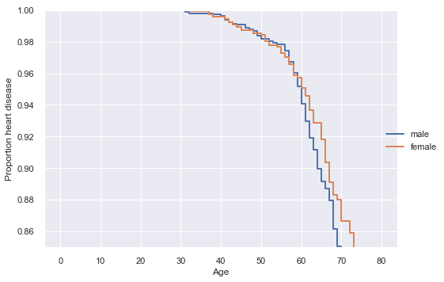
Biostatistics: Survival plot (age of onset) by gender

Slide 36
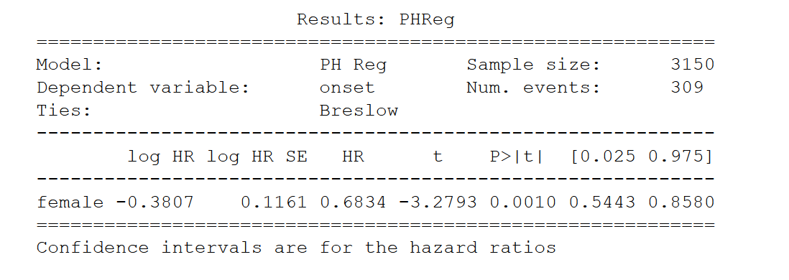
Biostatistics: Cox PH test gender difference

Slide 37
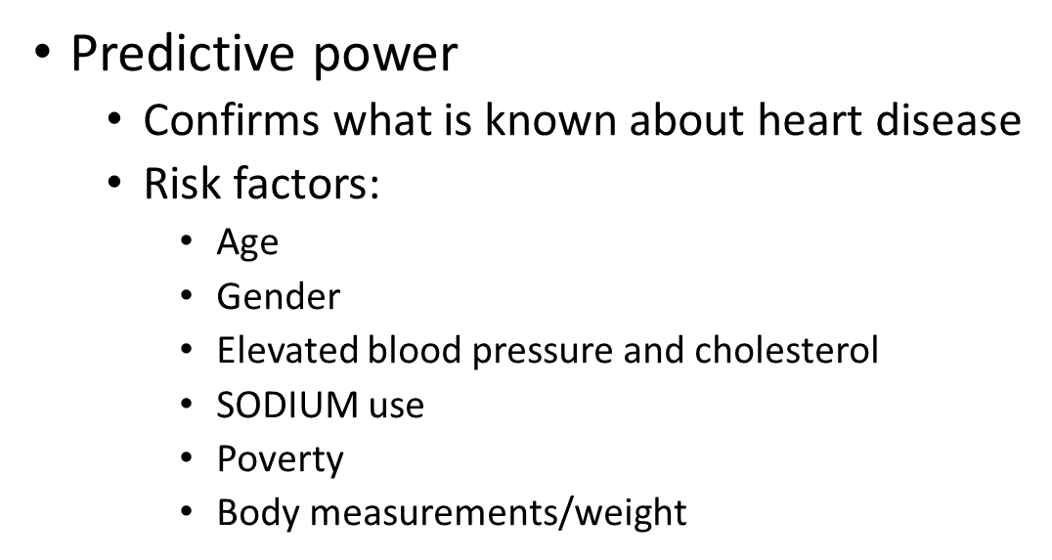
The practical uses of the model

Slide 38
Weak points/shortcomings of model
Small data set
Lack of focus with multiple features
Trade-off between precision/accuracy vs recall on target value
False positives are acceptable to a point
Little new actionable information
Going forward:
Inclusion of additional data (years of data available)
Focus only on nutrition and diet features

Slide 39
Conclusions
Healthcare in the United States is among the costliest and most inefficient in the industrialized world
Efforts to improve care and reduce expenses is in the best interest of all involved
Better understanding of the factors which contribute to the incidence of heart disease is vital in improving care and reducing expenses

